Slide 1

End-to-end Neural Coreference Resolution Kenton Lee, Luheng He, Mike Lewis, and Luke Zettlemoyer

Slide 2
Key Words
Co reference Resolution
Identify all mentions that refer to the same entity in the word
Reference
Co reference
Anaphora
Catefara

Slide 3
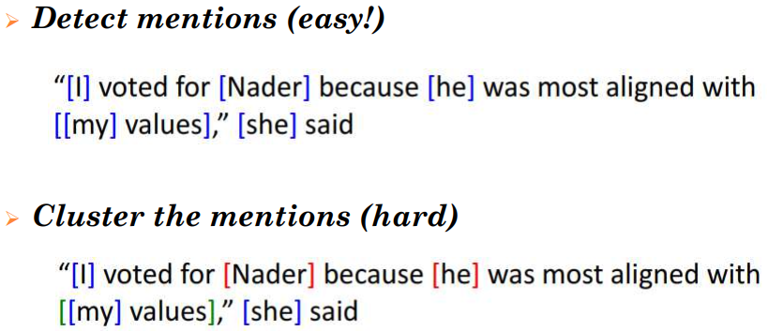
STEPS IN COREFERENCE RESOLUTION

Slide 4
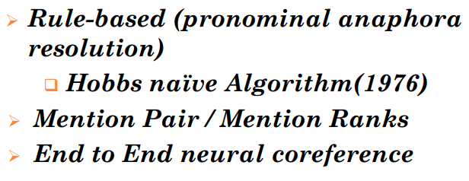
HISTORY OF COREFERENCE MODEL

Slide 5
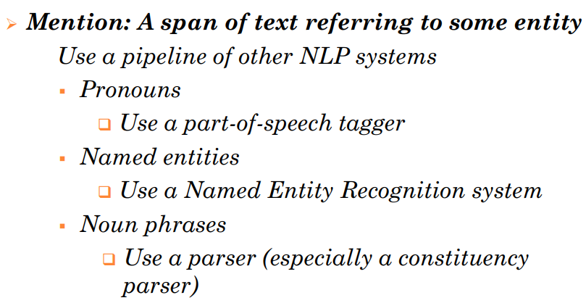
MENTION DETECTION

Slide 6
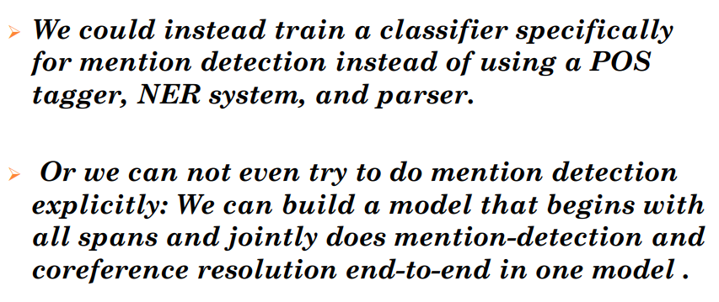
AVOIDING A TRADITIONAL PIPELINE SYSTEM

Slide 7
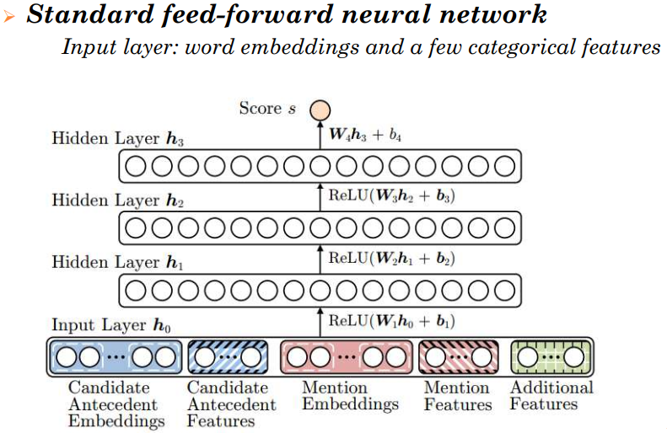
NEURAL COREF. MODEL [CLARK AND MANNING 2016]

Slide 8
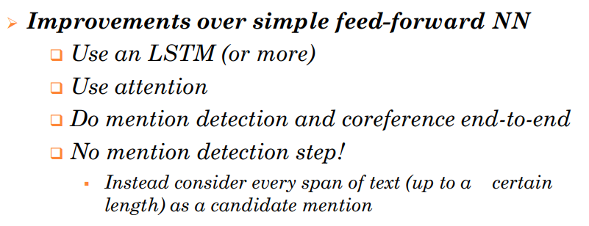
END-TO-END NEURAL COREF. MODEL

Slide 9
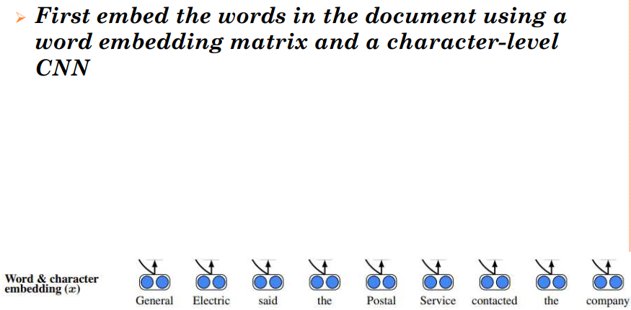
END TO END MODEL (COUNT.)

Slide 10
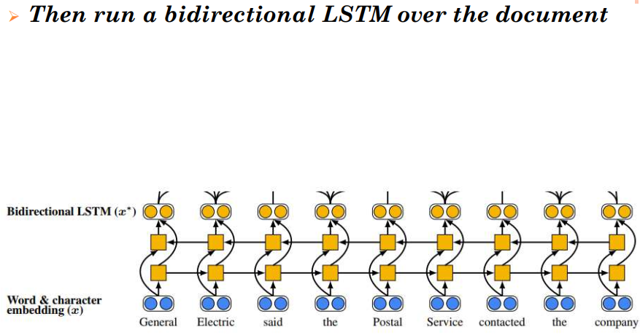
END TO END MODEL (COUNT.)

Slide 11
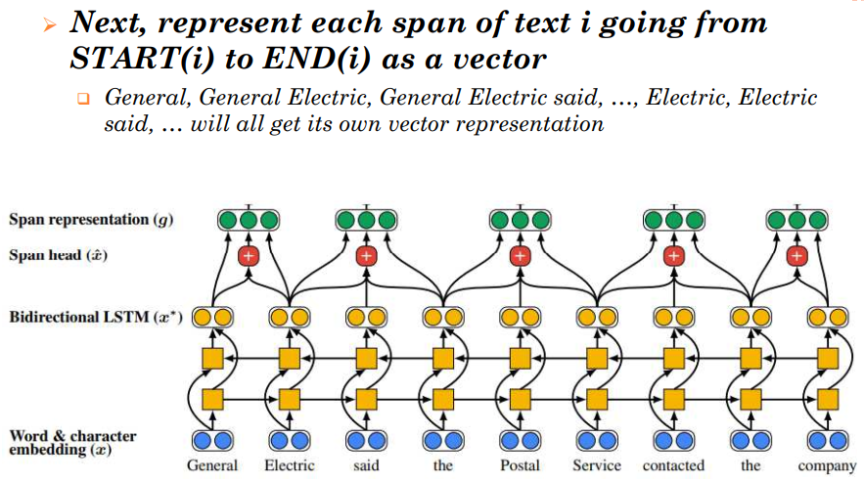
END TO END MODEL (COUNT.)

Slide 12
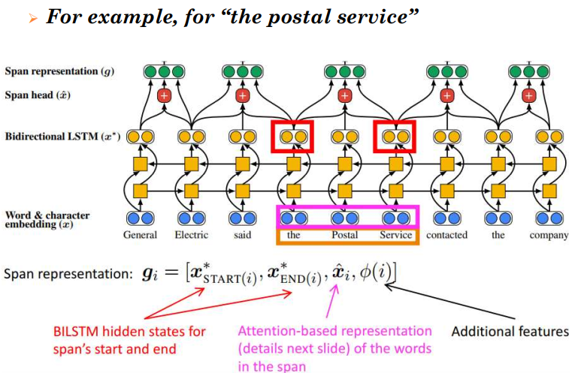
END TO END MODEL (COUNT.)

Slide 13
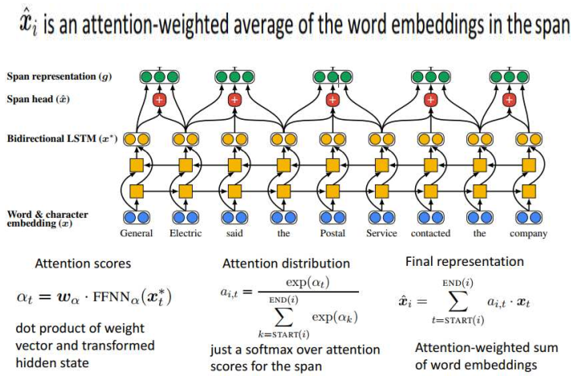
END TO END MODEL (COUNT.)

Slide 14
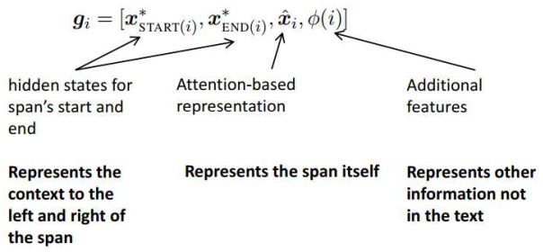
END TO END MODEL (COUNT.)

Slide 15
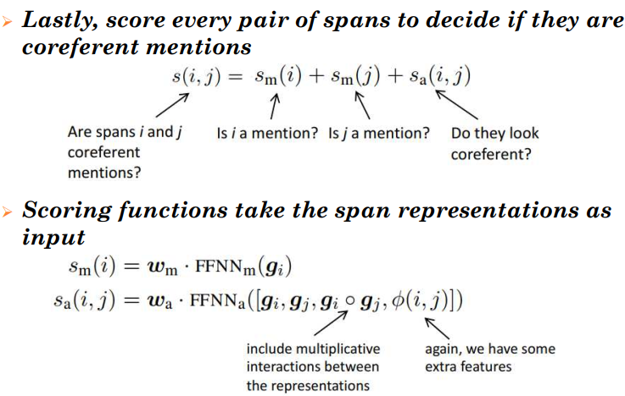
END TO END MODEL (COUNT.)

Slide 16
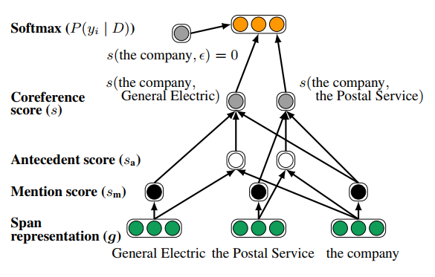
Second step of our model

Slide 17
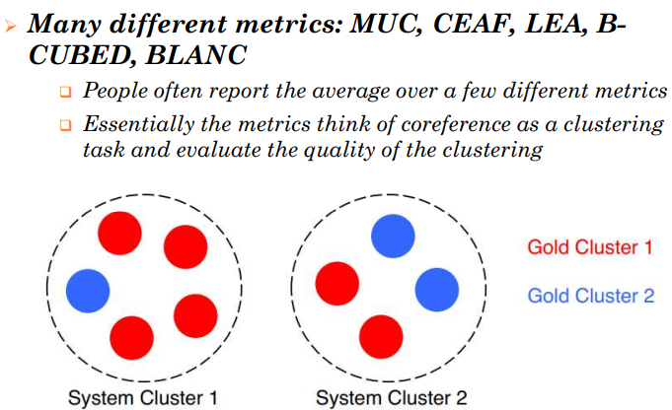
COREFERENCE EVALUATION

Slide 18
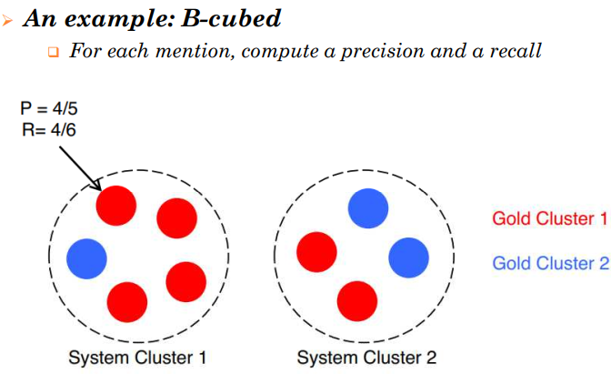
COREFERENCE EVALUATION (COUNT.)

Slide 19
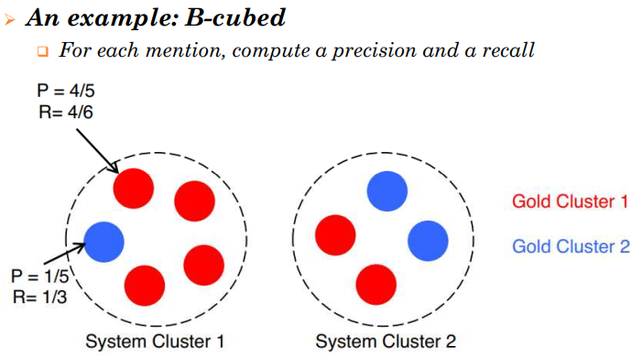
COREFERENCE EVALUATION (COUNT.)

Slide 20
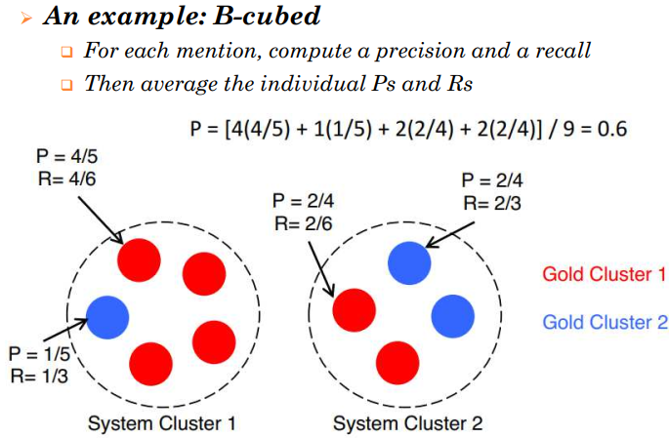
COREFERENCE EVALUATION (COUNT.)

Slide 21
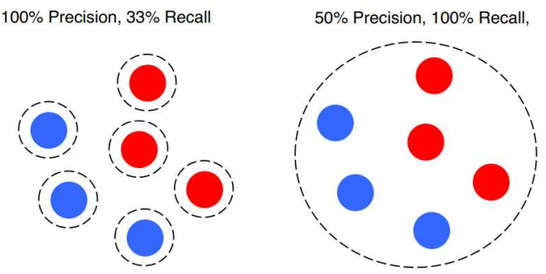
COREFERENCE EVALUATION (COUNT.)

Slide 22
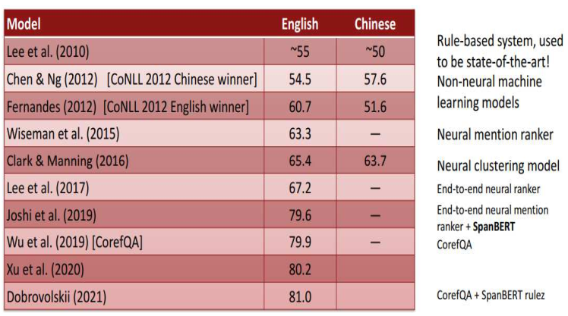
SYSTEM PERFORMANCE

Slide 23
Thank you for your attention

